Slide 1

Crime, Home Value, and School Exposure: Insights from a Spatial Analysis of Montgomery County
Leika Ray Joseph
DATA 205
Lori Perine
05/12/2025

Slide 2

Introduction
Focus: Exploring the relationship between crime, housing, and school safety in Montgomery County
Why it matters: These factors directly influence community well-being, public trust, and local equity
Approach: Use spatial and statistical analysis with publicly available datasets
Goal: Uncover patterns that can support better decision-making in planning, education, and public safety

Slide 3

Objectives & Research Questions
Objectives:
Examine crime patterns over time and across locations in Montgomery County
Investigate potential relationships between crime and median home values
Analyze the proximity of schools to high-crime areas
Research Questions:
Do cities with higher crime have lower home values?
Are specific types of crime more strongly tied to housing patterns?
Are public schools located in areas with higher crime exposure?

Slide 4

Datasets Used
1- Crime Dataset
Source: Data Montgomery
Over 437,000 observations from 2016-2025
Cleaned for missing data, incorrect locations, and out-of-county entries.
2- Census Housing Dataset
Median home values by city
Source: US. Census
2- Public School Dataset (Data Montgomery)
200 public schools
Includes school name, type, and coordinates
Tools used: OpenRefine, RStudio, Python

Slide 5

Tools & Platforms
OpenRefine – Used for early data cleaning (e.g., fixing city name inconsistencies)
RStudio – Used for deeper cleaning, visualization, and exploratory analysis
Google Colab (Python) – For statistical tests, proximity calculations, and mapping
Folium – Built interactive maps to visualize crime density and school locations

Slide 6
Data Cleaning Highlights
Fixed inconsistent city names and removed irrelevant locations
Reformatted dates and extracted month/year for time analysis
Filtered out 2025 records and non-Montgomery County entries
Combined datasets by city and coordinates for deeper comparisons

Slide 7
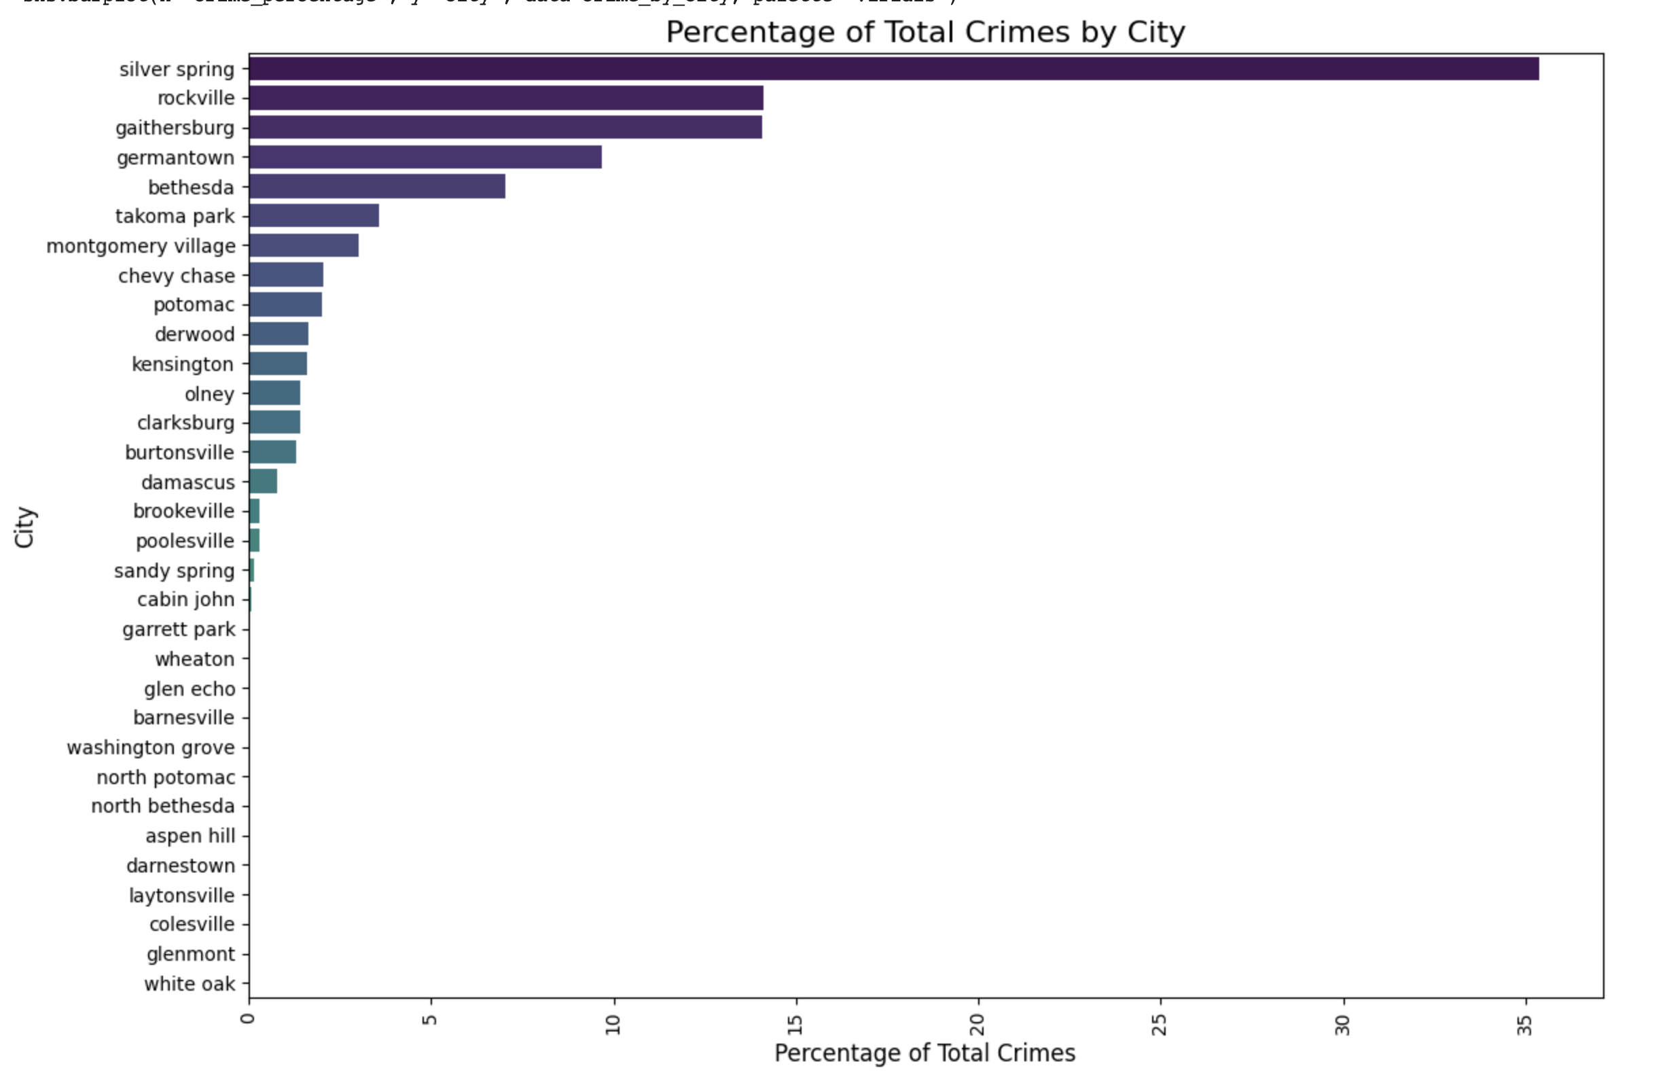
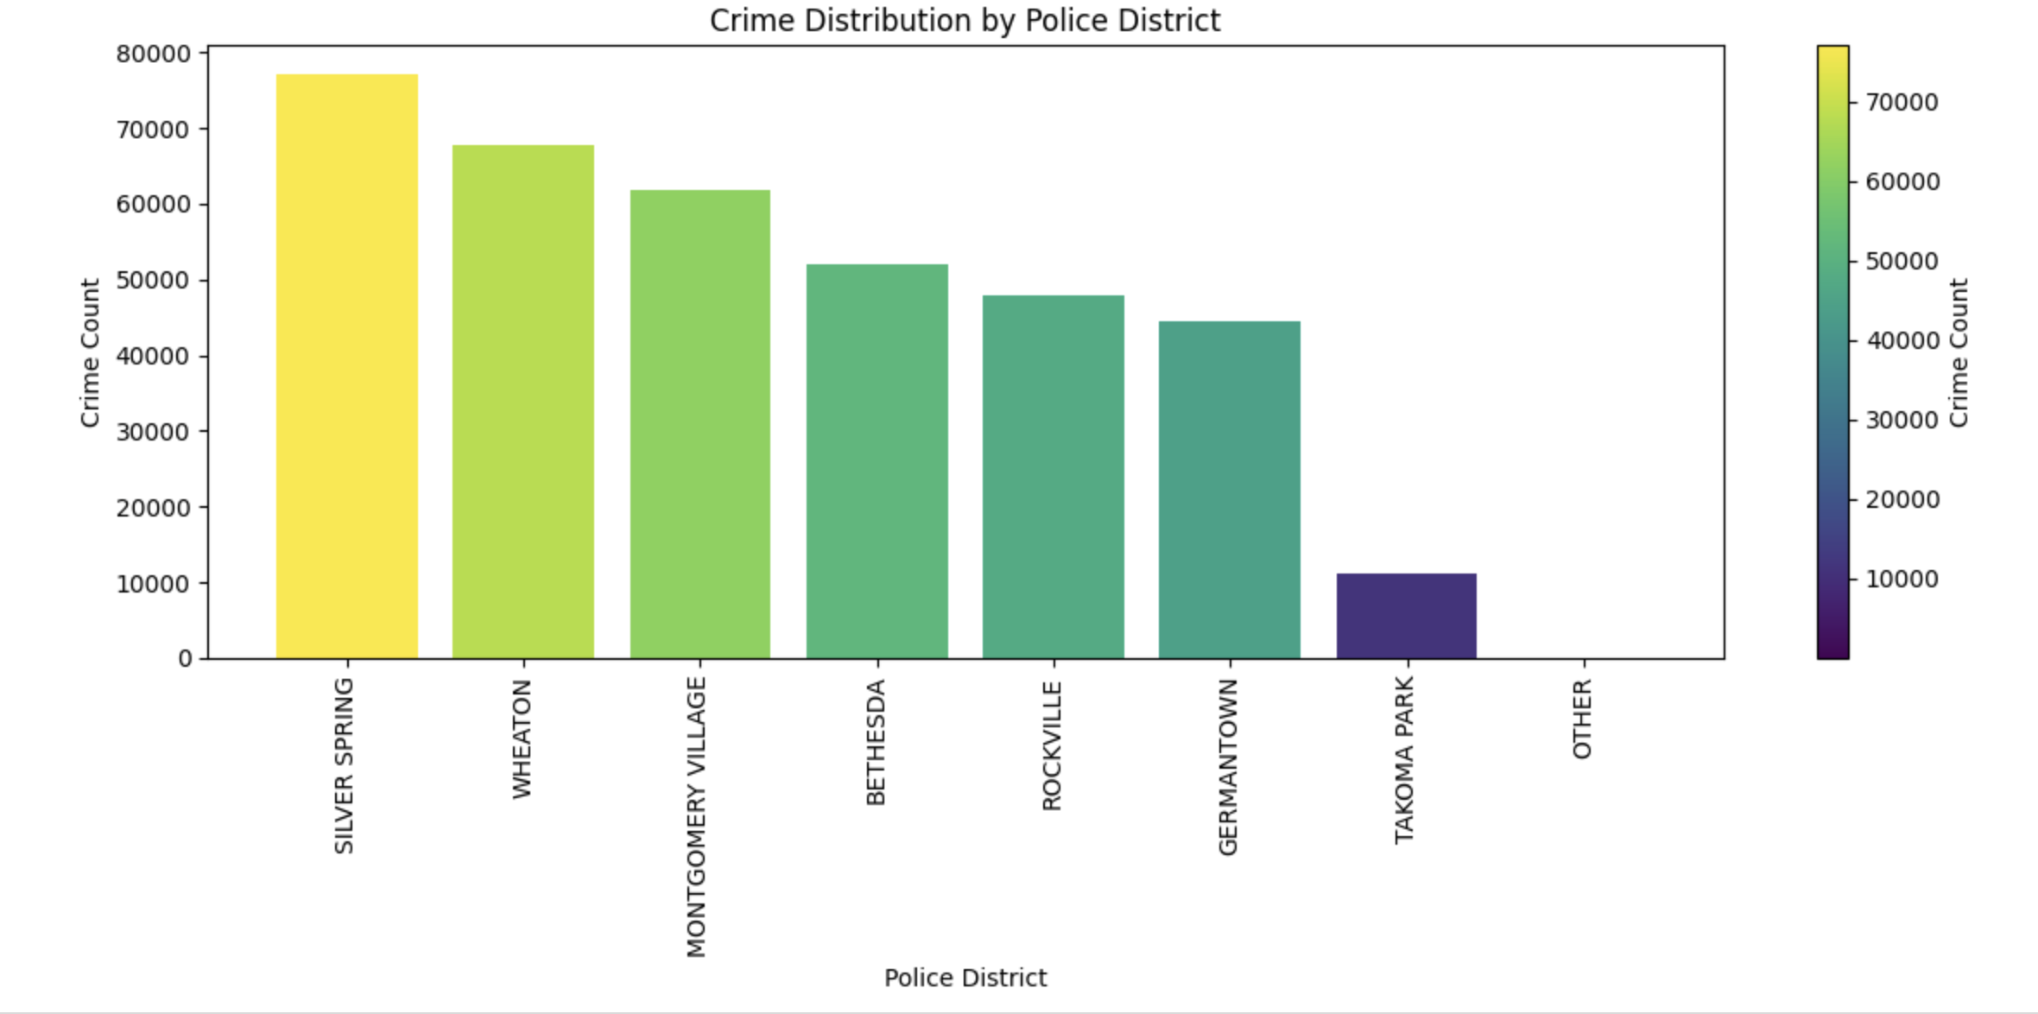
Crime Overview
Silver Spring accounts for over one-third of all reported crimes, followed by Rockville and Gaithersburg.

Slide 8
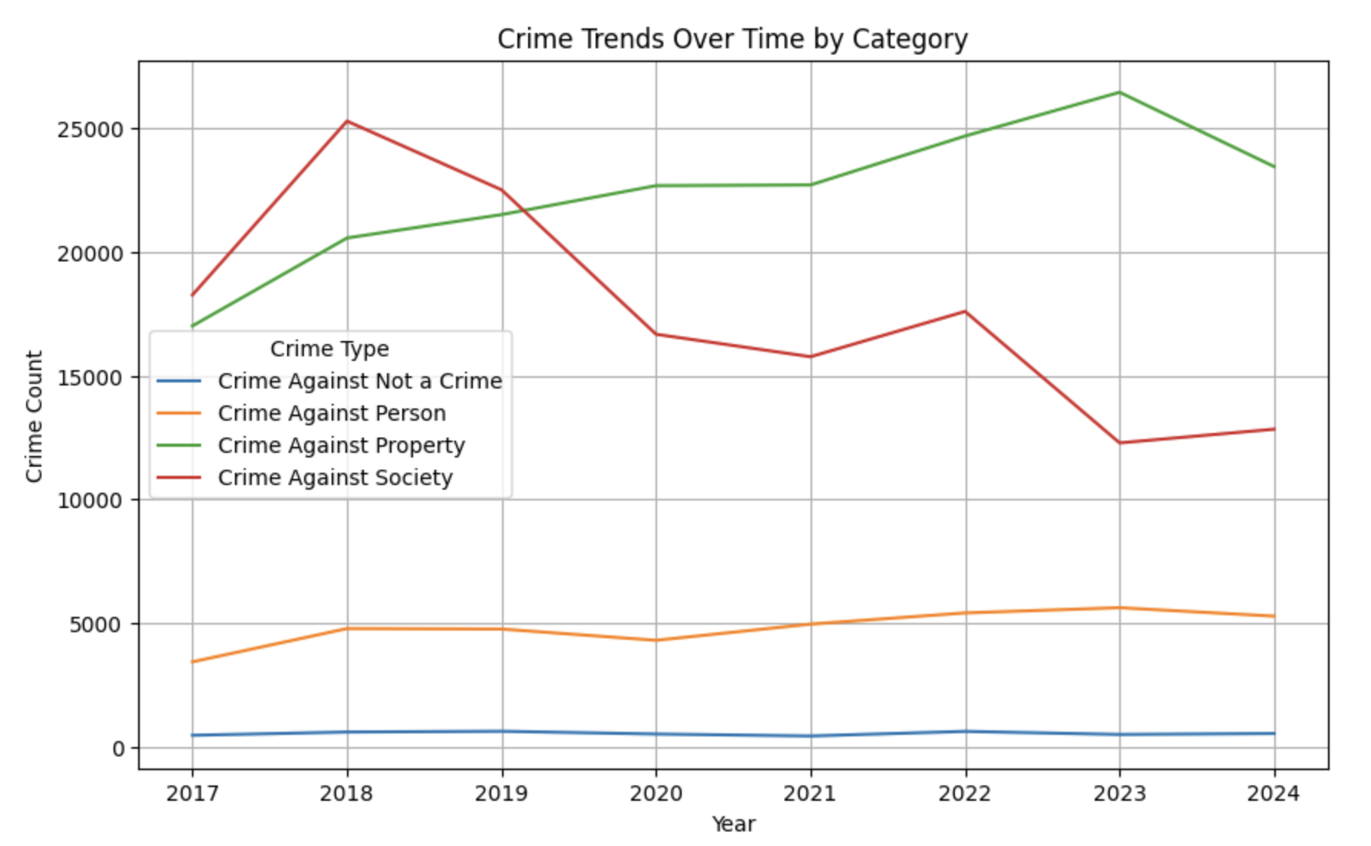
Crime Trends Over Time
Property crimes are the most common type of crime and have steadily increased since 2017.
Crimes against society declined significantly after 2019, likely due to pandemic-related changes.
Crimes against persons remained relatively stable over the years.
Overall crime patterns reflect both social conditions and enforcement shifts over time.

Slide 9
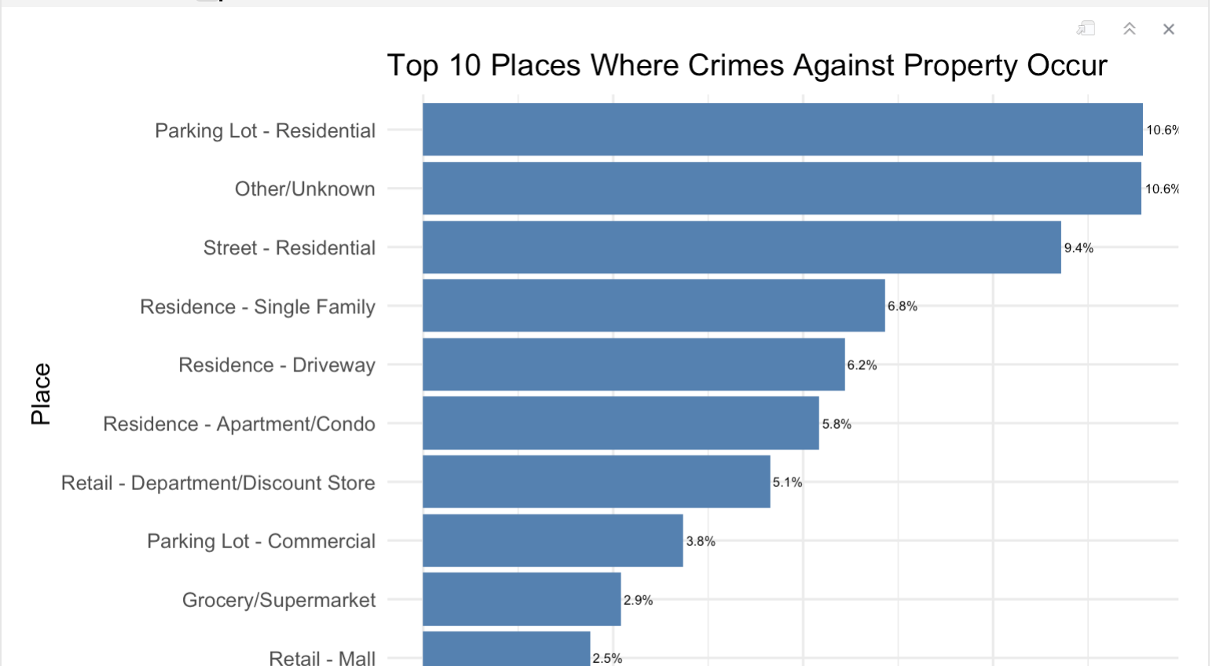
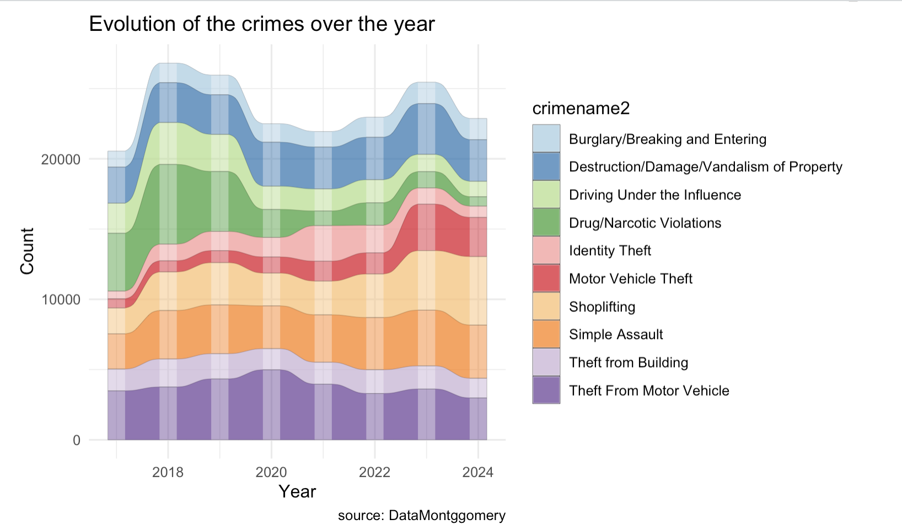
Top Crimes & Locations
Residential areas especially parking lots are the most frequent crime scenes.
Shoplifting is steadily increasing, while drug violations are declining.
Crime types like motor vehicle theft and simple assault remain consistently high.

Slide 10
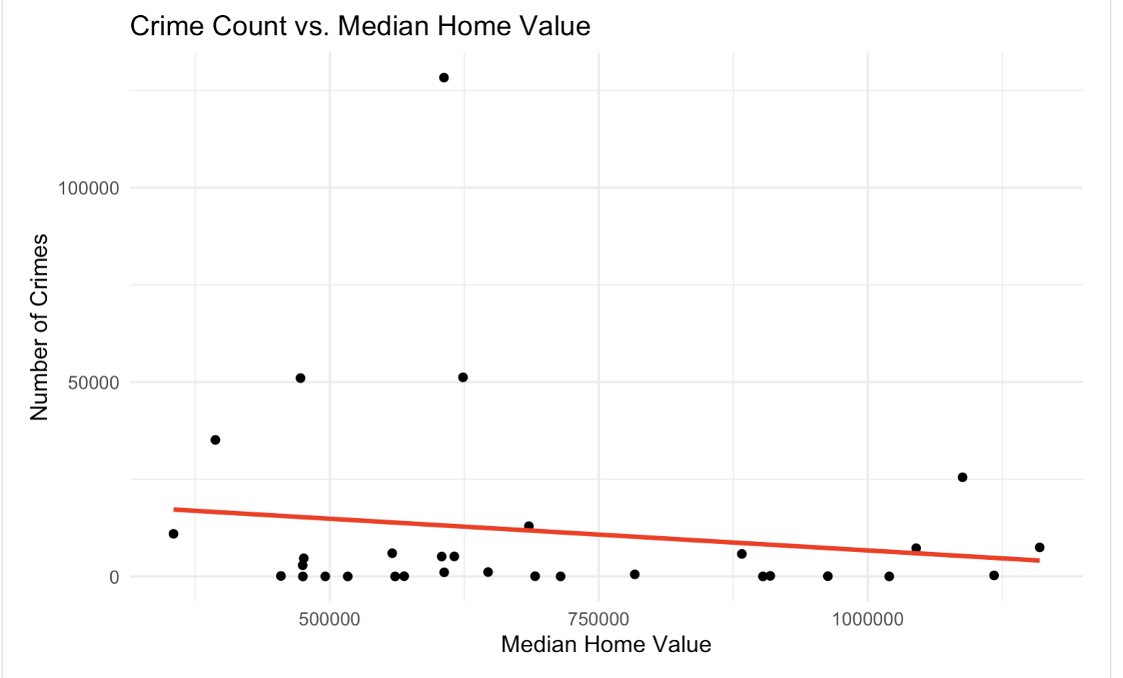
Housing Value vs. Crime
Compares total crime count to median home value across cities in Montgomery County
The trendline shows a very weak negative correlation between crime and home values.
Both high- and low-value housing areas experience a wide range of crime levels.
Overall crime does not explain variation in home prices.
With a p-value of 0.43 and R² of just 2%, the relationship is not statistically significant.

Slide 11
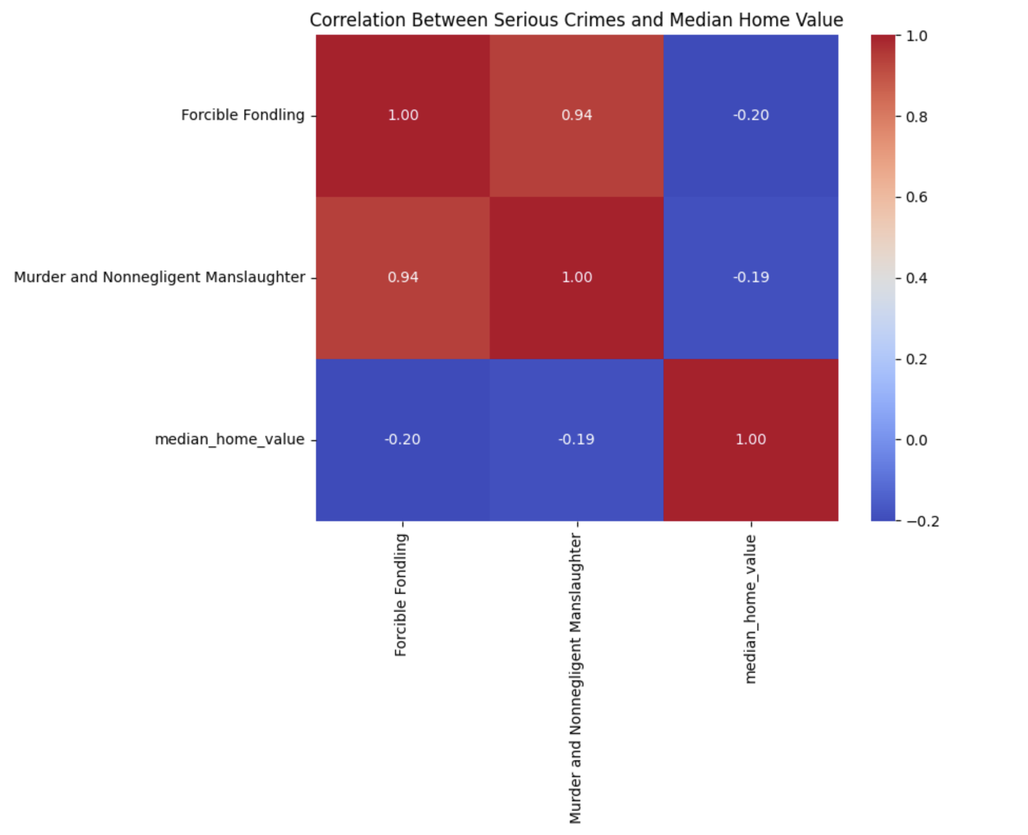
Correlation Between Violent Crimes and Home Value
Focused on crimes that showed statistically significant results from t-tests
Moderate negative correlation between serious crimes and home values
Certain violent crimes may influence housing market perception
Not all crime types impact communities equally

Slide 12
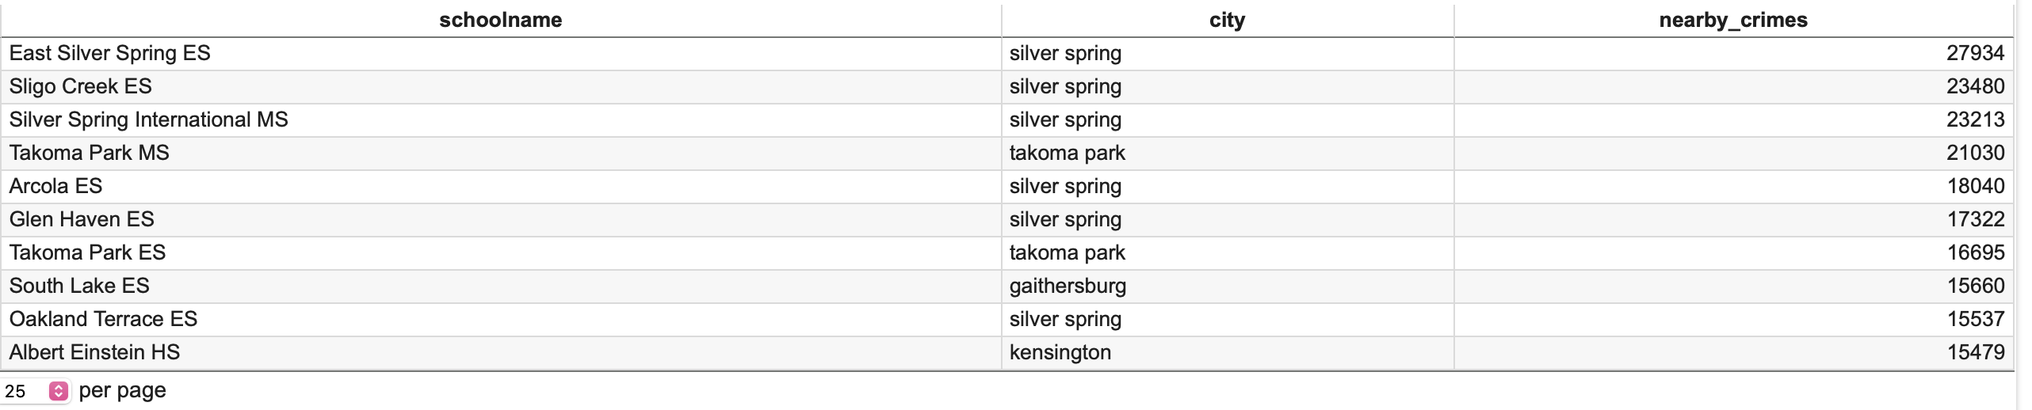
School Proximity to Crime
Top 10 schools in Montgomery County with the highest number of crimes reported within a 1-mile radius.
Schools in Silver Spring and Takoma Park dominate the list, aligning with earlier identified crime hotspots.
East Silver Spring ES alone had over 27,000 nearby incidents, highlighting potential concerns about student environment.

Slide 13
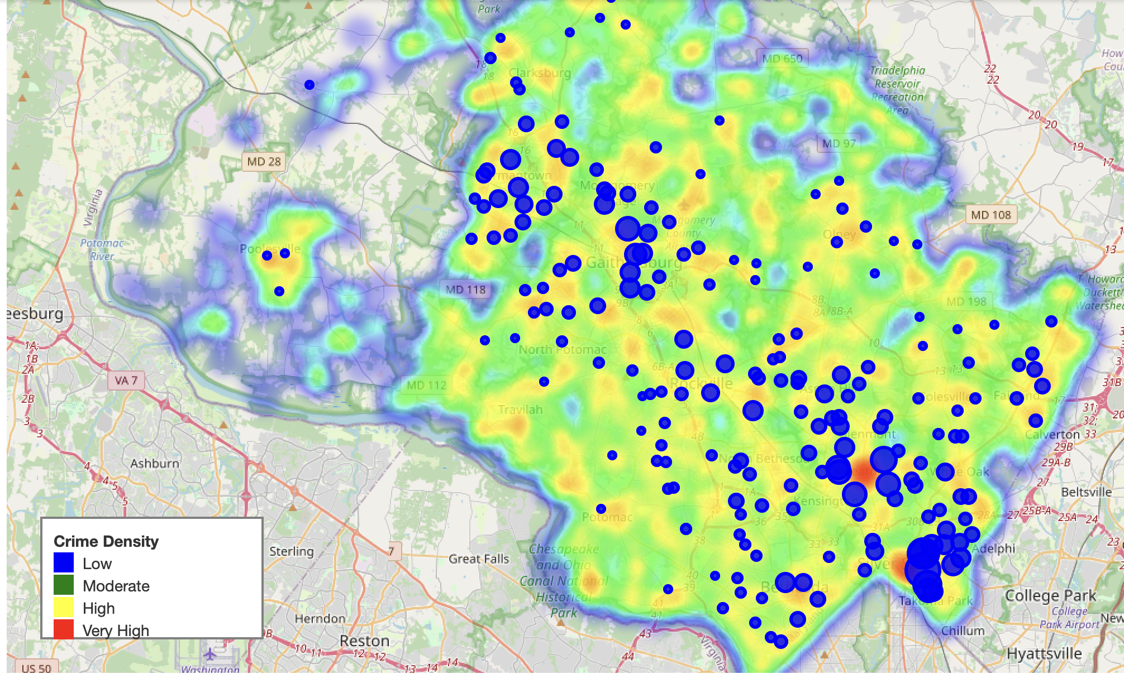
Crime Heatmap
Crime density across Montgomery County using color gradients
Schools in areas like Silver Spring and Takoma Park are located in high-crime zones.

Slide 14

Limitations & Challenges
The analysis did not include socioeconomic factors
The analysis was limited to reported crimes within Montgomery County. Crimes near county borders or unreported incidents were not captured, which may influence local exposure patterns.
The public school dataset lacked performance or enrollment data, preventing a more comprehensive understanding of how crime may influence educational outcomes.

Slide 15
Conclusion
Crime in Montgomery County shows clear patterns both over time and across geography with property crime being the most frequent.
While overall crime does not significantly relate to home values, specific violent crimes such as murder, forcible fondling, and statutory rape show measurable associations with lower property values.
Schools located in cities with higher crime counts especially Silver Spring and Takoma Park tend to be in areas with greater exposure to crime

Slide 16
What Could come next next?
Investigate the types of crimes occurring near schools, especially elementary schools in high-crime zones
1
Explore crime timing and seasonal patterns (e.g., late-night activity and May spikes) to assess potential risks during school hours or commutes.
2
Incorporate school-level data, like enrollment, performance, or demographics, to better understand vulnerability and equity
3

Slide 17

Acknowledgment
I would like to thank Professor Lori Perine for her continued support, guidance, and thoughtful feedback throughout this project.
Special thanks to Professors Celia Evans and Rachel Saidi for their inspiration and instructions.
Thanks to the creators of OpenRefine, RStudio, and Python tools, as well as the broader open data community for enabling this work.

Slide 18

Thank You for Listening

Slide 19
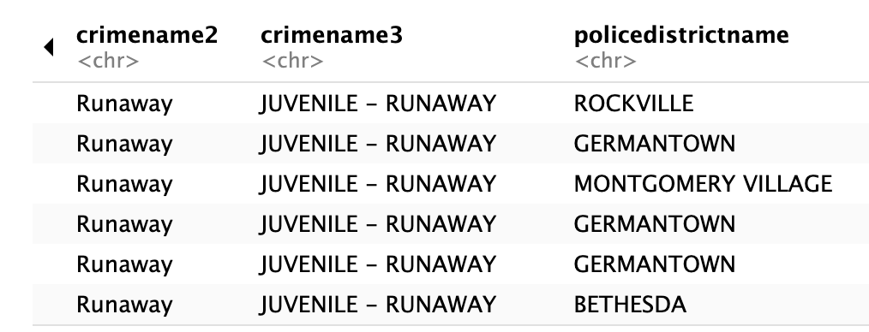
Not a crime category

Slide 20
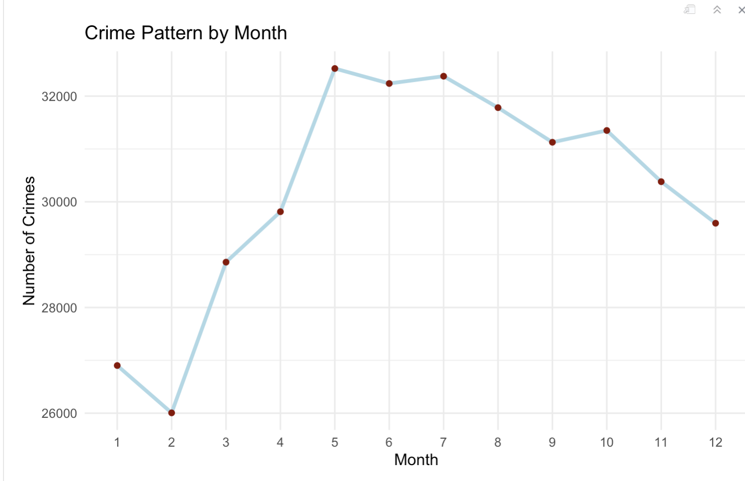
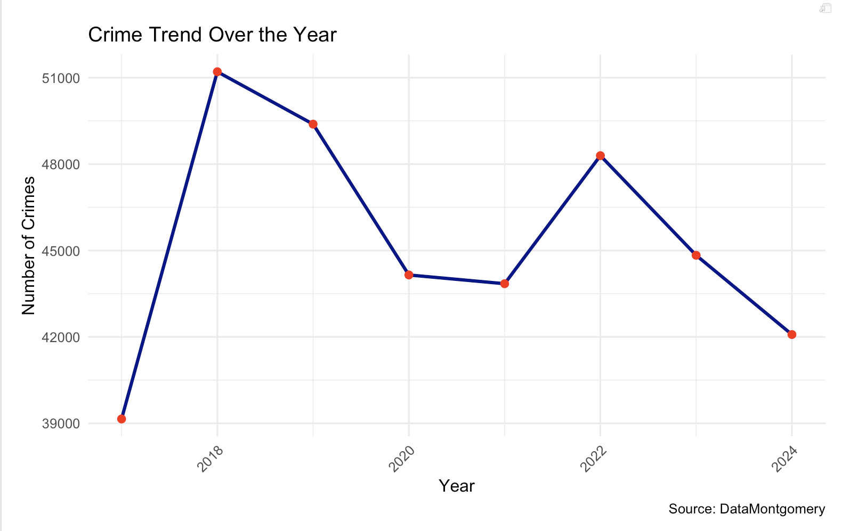
Extra visualizations

Slide 21
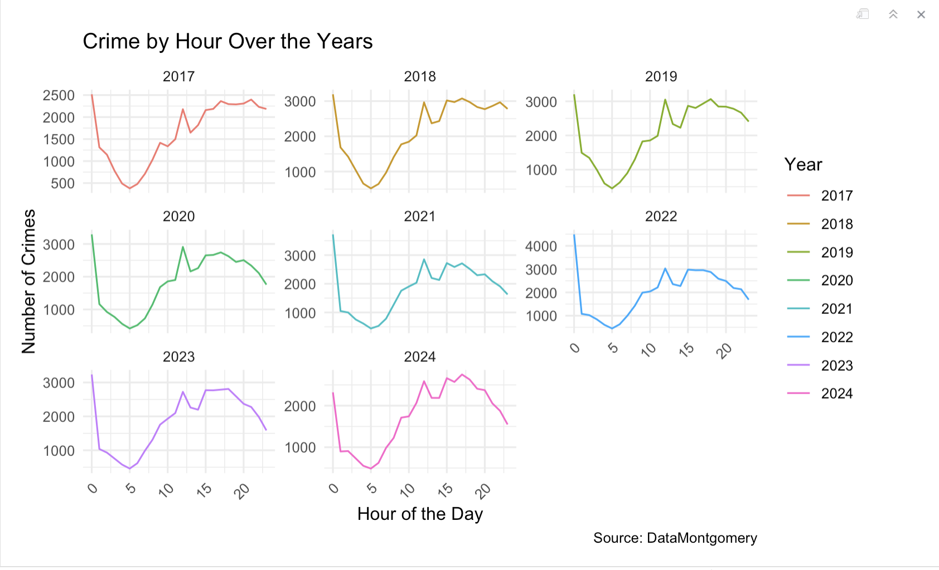
Crime by Hour

